Slide 1

Quantum Communications Group
Weekly Report
Supervisors:
Armando Nolasco Pinto
anp@ua.pt
Diogo Matos
dftm@ua.pt

Slide 2
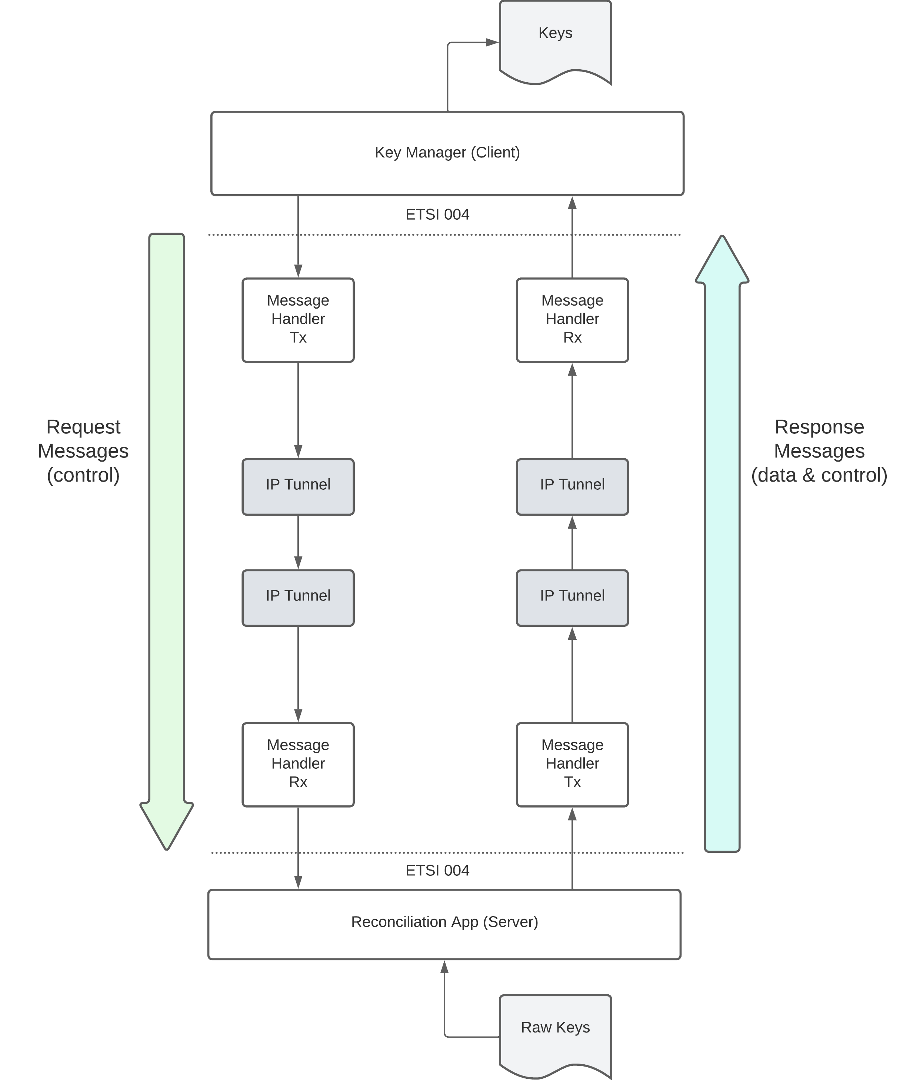
Diagram for the South interface
The interface between the Key Manager and the Reconciliation App is based on ETSI QKD 004 in push mode (the KMS is always receiving keys without making individual requests for each one).
The KMS will start by making an OPEN_CONNECT request to create a connection to the Reconciliation App. Then does one GET_KEY request and from that moment forward it will receive key material with the characteristics and pace specified in the QoS field until it makes a CLOSE request to terminate the key stream.

Slide 3
Initial Approach
We tried to implement 2 apps using a client-server approach. The client sends an open_connect request to the server and when the connection is established it sends a get_key request. After receiving 10 successive keys it closes the connection with a close request.​ We are having difficulties with the usage of the message_handler block and the ETSI 004 implementation.
Notes:
We tried to implement 2 apps using a client-server approach. The client sends an open_connect request to the server and when the connection is established it sends a get_key request. After receiving 10 successive keys it closes the connection with a close request. We are having difficulties with the usage of the message_handler block and the ETSI 004 implementation.

